Slide 1


SOCSE
BIG DATA ANALYTICS - PRESENTATION
2025-26
PROJECT TOPIC: Analysis of Clash of Clans player communities
PROJECT GROUP BATCH: A3
Presentation By:
Prabhas Bhat 1RVU22BSC069
Prasanna G 1RVU22BSC072
Mershika U 1RVU22BSC052
Jyosthna C 1RVU22BSC021
Guided By:
Prof.Vinod Kumar Raju
Assistant Professor
SOCSE
RV University

Slide 2
AGENDA
INTRODUCTION
PROBLEM STATEMENT
OBJECTIVES
DATASET
IMPLEMENTATION
SOFTWARE REQUIREMENTS
RESULTS
CONCLUSION

Slide 3
INTRODUCTION
Online games like Clash of Clans generate huge amounts of data from millions of players.
Clan-related data includes clan types, leagues, points, levels and number of members.
Traditional single-node systems struggle to process such large datasets efficiently.
Big Data tools are required to store, process, and analyze this data at scale.
This project analyzes 3.56 million clan records using Apache Spark and Apache Hive.

Slide 4
PROBLEM STATEMENT
Online gaming platforms like Clash of Clans generate massive volumes of structured data related to player clans, rankings, and league behaviors.
Traditional single-node data processing systems, such as Apache Hive on a virtual machine, face scalability and performance limitations when handling large-scale datasets.
There is a need to evaluate and compare the performance of single-node versus multi-node data processing architectures for large gaming datasets.
This project addresses the challenge of identifying an optimal big data analytics framework for processing and analyzing millions of rows of gaming data efficiently.

Slide 5
OBJECTIVES
To analyze the Clash of Clans dataset by studying the distribution of clan types and the behavioral patterns of clans across different ranked leagues using large-scale gaming data.
To implement and execute aggregation-based analytics on a dataset of approximately 3.56 million records using both a single-node Apache Hive setup and a multi-node Apache Spark cluster on Google Cloud Platform.
To compare and evaluate system performance by measuring execution times and analyzing the efficiency and scalability of multi-node Spark versus single-node Hive for gaming big data analytics.

Slide 6
DATASET DETAILS
Dataset : Clash Of Clans
The dataset contains around 3.56 million clan records collected from the popular mobile game Clash of Clans. It is a large-scale CSV dataset, representing real-world gaming data and is well-suited for Big Data analysis using distributed systems like Apache Spark and Apache Hive.
Each record includes 27 attributes, such as clan tag, clan name, clan type (open / invite-only / closed), clan war league, clan points, clan level, number of members, location details, and war statistics.
These features enable a detailed analysis of clan behavior, league distribution, and engagement patterns.

Slide 7
IMPLEMENTATION
WORKFLOW FOR GCP | WORKFLOW FOR HIVE
1.Upload dataset to bucket | 1.Upload the dataset into Hadoop fs with put command.
2.Create a multi node cluster with 2 worker nodes and Jupyter lab interface enabled. | 2.Initialize hive in CLI
3.Open Jupyter lab notebook in the cluster and choose spark language for cells. | 3.Make a table with all necessary columns
4.Load the dataset from bucket | 4.Insert data from Hadoop fs into the table.
5.Run aggregations and record execution times for each. | 5.Run aggregations on the table and record execution times for each.

Slide 8
SOFTWARE & HARDWARE REQUIREMENTS
Software Requirements :
Apache Spark - Used for fast, distributed data processing on large datasets.
Apache Hive - Used for SQL-based querying and aggregation on large data.
Python (PySpark) - Used to write Spark programs and perform analytics.
Google Cloud Platform (GCP) - Used to create and manage the multi-node Spark cluster.
Linux Operating System - Used as the base operating system for both Spark and Hive environments.
Hardware Requirements :
Multi-node Cluster on Google Cloud Platform
Master Node: 4 vCPUs, 15 GB RAM
Worker Node(s): 2 vCPUs, 7.5 GB RAM
Single-node Virtual Machine (Cloudera VM)
CPU: 1 Processor
Memory: 5 GB RAM
Storage: 64 GB Disk

Slide 9
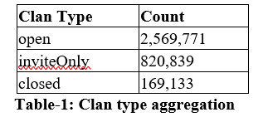
RESULTS
Clan Type Distribution Results:
Open clans dominate the dataset with over 2.5 million clans, showing a strong preference for accessible and casual gameplay communities.
Invite-only and closed clans are fewer, indicating more structured and controlled participation among competitive players.

Slide 10
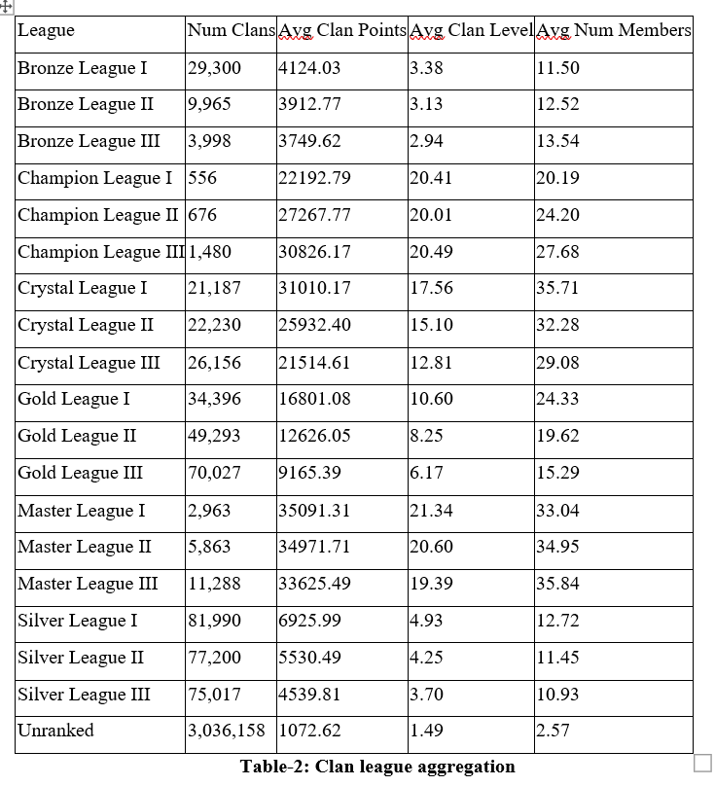
League-wise Aggregation Results :
Unranked clans dominate the dataset, while higher leagues such as Champion and Master show fewer but more competitive clans with higher points, levels, and member counts.

Slide 11
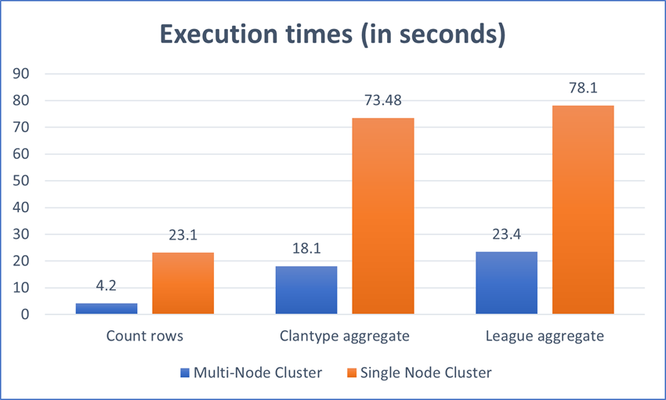
Performance Comparison : The Spark cluster consistently outperformed the single-node Hive environment:
Up to 5×–10× faster execution times.
Better scalability for large aggregations.
Execution time comparison :

Slide 12
CONCLUSION
The results prove that Apache Spark running on a multi-node GCP cluster provided substantial performance benefits over a single-node Hive setup when dealing with big datasets.
The Spark cluster benefits from parallel execution, in-memory computation, and efficient task scheduling, while the single-node Hive setup is limited by disk I/O and sequential processing.
This analysis confirms that distributed computing frameworks such as Spark are better suited for scalable, real-world big data applications like online gaming analytics.

Slide 13
Thank You

